Slide 1
Rock talk rock talk (rip evan)

Slide 2
A.S.S. Meeting
ROCK TALK- Evan Bowen
11/2/2023

Slide 3
Announcements:
ASSoween!
  Spooky ASS activities
Vertical Trainings
  Signup genius pinned in groupme!
0-9 Well & Amazing Maze 11/3-11/5
  Very wet, very vertical, wowza
Deep & Punkin 11/10-11/12
  Signup QR code in a second
  Evan will be there

Slide 4
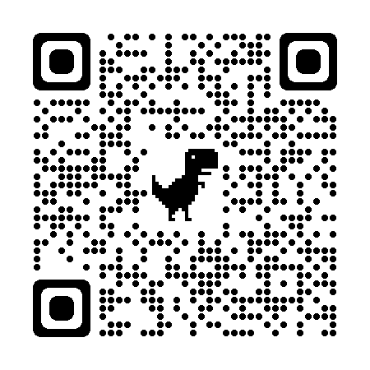
D&P Signup:

